Slide 1
Module 1
Introduction to object oriented programming

Slide 2
Introduction to properties of object oriented programming
Object-Oriented Programming (OOP) is the term used to describe a programming approach based on objects and classes. The object-oriented paradigm allows us to organize software as a collection of objects that consist of both data and behavior.
The object-oriented programming approach encourages:
1)Modularization: where the application can be decomposed into modules.
2)Software re-use: where an application can be composed from existing and new modules.

Slide 3
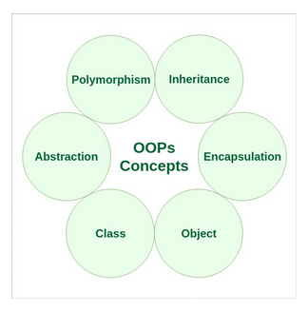
Characteristics of an Object Oriented Programming language:

Slide 4
CLASS
The building block of C++ that leads to Object-Oriented programming is a Class. It is a user-defined data type, which holds its own data members and member functions, which can be accessed and used by creating an instance of that class. A class is like a blueprint for an object.

Slide 5
OBJECT
An Object is an identifiable entity with some characteristics and behavior. An Object is an instance of a Class. When a class is defined, no memory is allocated but when it is instantiated (i.e. an object is created) memory is allocated.
class person
{
char name[20];
int id;
public:
void getdetails(){}
};
int main()
{
person p1; // p1 is a object
}

Slide 6
ENCAPSULATION
In normal terms, Encapsulation is defined as wrapping up of data and information under a single unit. In Object-Oriented Programming, Encapsulation is defined as binding together the data and the functions that manipulate them.

Slide 7
ABSTRACTION
Data abstraction is one of the most essential and important features of object-oriented programming in C++. Abstraction means displaying only essential information and hiding the details. Data abstraction refers to providing only essential information about the data to the outside world, hiding the background details or implementation.

Slide 8
POLYMORPHISM
The word polymorphism means having many forms. In simple words, we can define polymorphism as the ability of a message to be displayed in more than one form.
A person at the same time can have different characteristic. Like a man at the same time is a father, a husband, an employee. So the same person posses different behavior in different situations. This is called polymorphism.

Slide 9
INHERITANCE
The capability of a class to derive properties and characteristics from another class is called Inheritance. Inheritance is one of the most important features of Object-Oriented Programming.
Sub Class: The class that inherits properties from another class is called Sub class or Derived Class.
Super Class : The class whose properties are inherited by sub class is called Base Class or Super class.
Reusability: Inheritance supports the concept of “reusability”, i.e. when we want to create a new class and there is already a class that includes some of the code that we want, we can derive our new class from the existing class. By doing this, we are reusing the fields and methods of the existing class.

Slide 10
Dynamic Binding: In dynamic binding, the code to be executed in response to function call is decided at runtime.
Message Passing: Objects communicate with one another by sending and receiving information to each other. A message for an object is a request for execution of a procedure and therefore will invoke a function in the receiving object that generates the desired results. Message passing involves specifying the name of the object, the name of the function and the information to be sent.

Slide 11
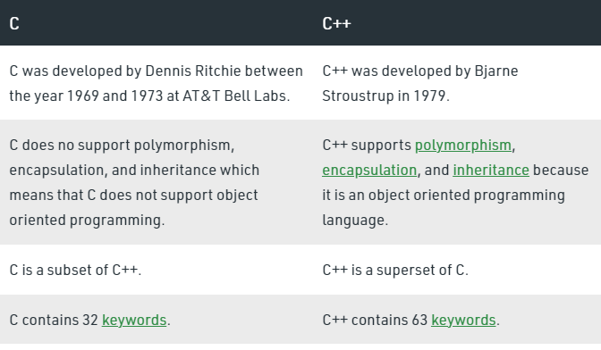
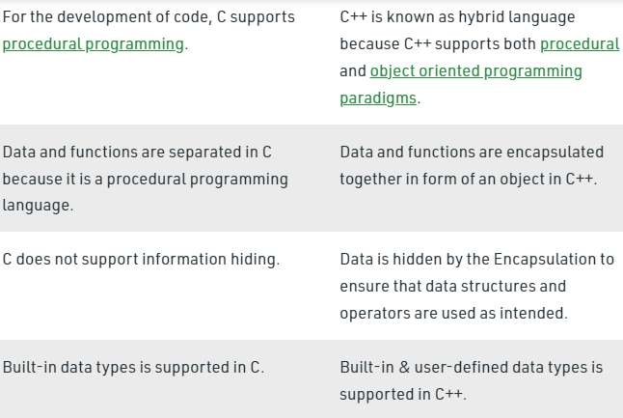
Difference between C and C++

Slide 12
Beginning with c++ programs
C++ "Hello World!" Program
// Your First C++ Program
#include <iostream>
using namespace std
int main()
{
cout << "Hello World!";
return 0;
}
Explanation:
// Your First C++ Program
In C++, any line starting with // is a comment. Comments are intended for the person reading the code to better understand the functionality of the program. It is completely ignored by the C++ compiler.
#include <iostream>
The #include is a preprocessor directive used to include files in our program. The above code is including the contents of the iostream file. This allows us to use cout in our program to print output on the screen. For now, just remember that we need to use #include <iostream> to use cout that allows us to print output on the screen.

Slide 13
int main() {...}
A valid C++ program must have the main() function. The curly braces indicate the start and the end of the function. The execution of code beings from this function.
std::cout << "Hello World!"; std::cout prints the content inside the quotation marks. It must be followed by << followed by the format string. In our example, "Hello World!" is the format string. Note: ; is used to indicate the end of a statement.
return 0;
The return 0; statement is the "Exit status" of the program. In simple terms, the program ends with this statement.

Slide 14
C++ Variables, Literals and Constants
In programming, a variable is a container (storage area) to hold data.To indicate the storage area, each variable should be given a unique name (identifier).
For example, int age=14;
C++ Literals
Literals are data used for representing fixed values. They can be used directly in the code. For example: 1, 2.5, 'c' etc.
Here, 1, 2.5 and 'c' are literals. Why? You cannot assign different values to these terms.
Here's a list of different literals in C++ programming.
1. Integers
2. Floating-point Literals
3. Characters
4. Escape Sequences
5. String Literals
C++ Constants
In C++, we can create variables whose value cannot be changed. For that, we use the const keyword. Here's an example:
const int LIGHT_SPEED = 299792458;
LIGHT_SPEED = 2500 // Error! LIGHT_SPEED is a constant.

Slide 15
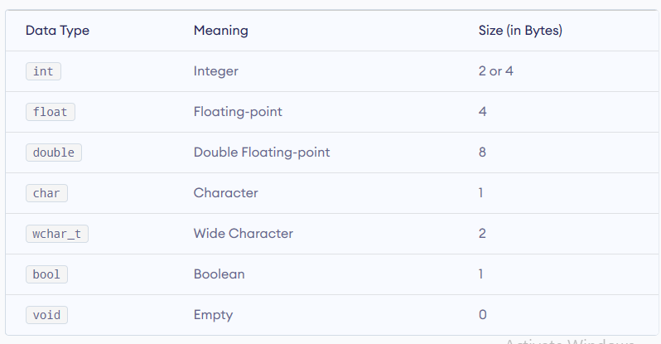
C++ Data Types

Slide 16
C++ Basic Input/Output
In C++, cout sends formatted output to standard output devices, such as the screen. We use the cout object along with the << operator for displaying output.
In C++, cin takes formatted input from standard input devices such as the keyboard. We use the cin object along with the >> operator for taking input.
C++ Type Conversion
C++ allows us to convert data of one type to that of another . This is known as type conversion.
There are two types of type conversion in C++.
Implicit Conversion
Explicit Conversion (also known as Type Casting)

Slide 17
Implicit Type Conversion
The type conversion that is done automatically done by the compiler is known as implicit type conversion. This type of conversion is also known as automatic conversion.
Let us look at two examples of implicit type conversion.
C++ Explicit Conversion
When the user manually changes data from one type to another, this is known as explicit conversion. This type of conversion is also known as type casting.
There are three major ways in which we can use explicit conversion in C++. They are:
C-style type casting (also known as cast notation)
Function notation (also known as old C++ style type casting)
Type conversion operators

Slide 18
Operators in C++
C++ divides the operators into the following groups:
Arithmetic Operators
Assignment Operators
Comparison Operators
Logical Operators
Bitwise Operators
C++ has the following conditional statements:
1) Use if to specify a block of code to be executed, if a specified condition is true
2) Use else to specify a block of code to be executed, if the same condition is false
3) Use else if to specify a new condition to test, if the first condition is false
4) Use switch to specify many alternative blocks of code to be executed

Slide 19
C++ While Loop
Syntax
while (condition)
{ // code block to be executed}
}

Slide 20
C++ Do/While Loop
The do/while loop is a variant of the while loop. This loop will execute the code block once, before checking if the condition is true, then it will repeat the loop as long as the condition is true.
Syntax
do
{ // code block to be executed
}
while (condition);

Slide 21
C++ For Loop
When you know exactly how many times you want to loop through a block of code, use the for loop instead of a while loop:
Syntax
for (statement 1; statement 2; statement 3)
{ // code block to be executed
}
Statement 1 is executed (one time) before the execution of the code block.
Statement 2 defines the condition for executing the code block.
Statement 3 is executed (every time) after the code block has been executed.

Slide 22
C++ Break and Continue
C++ Break
You have already seen the break statement used in an earlier chapter of this tutorial. It was used to "jump out" of a switch statement.
The break statement can also be used to jump out of a loop.
C++ Continue
The continue statement breaks one iteration (in the loop), if a specified condition occurs, and continues with the next iteration in the loop.

Slide 23
C++ Arrays
Arrays are used to store multiple values in a single variable, instead of declaring separate variables for each value.
To declare an array, define the variable type, specify the name of the array followed by square brackets and specify the number of elements it should store:
string cars[4];
We have now declared a variable that holds an array of four strings. To insert values to it, we can use an array literal - place the values in a comma-separated list, inside curly braces:
string cars[4] = {"Volvo", "BMW", "Ford", "Mazda"};
To create an array of three integers, you could write:
int myNum[3] = {10, 20, 30};

Slide 24
Access the Elements of an Array
You access an array element by referring to the index number.
This statement accesses the value of the first element in cars:
Example
string cars[4] = {"Volvo", "BMW", "Ford", "Mazda"}; cout << cars[0]; // Outputs Volvo

Slide 25
C++ Pointers
A pointer however, is a variable that stores the memory address as its value.
A pointer variable points to a data type (like int or string) of the same type, and is created with the * operator. The address of the variable you're working with is assigned to the pointer:
Example
string food = "Pizza"; // A food variable of type string
string* ptr = &food; // A pointer variable, with the name ptr, that stores the address of food // Output the value of food (Pizza) cout << food << "\n"; // Output the memory address of food (0x6dfed4) cout << &food << "\n"; // Output the memory address of food with the pointer (0x6dfed4) cout << ptr << "\n";

Slide 26
Example explained
Create a pointer variable with the name ptr, that points to a string variable, by using the asterisk sign * (string* ptr). Note that the type of the pointer has to match the type of the variable you're working with.
Use the & operator to store the memory address of the variable called food, and assign it to the pointer.
Now, ptr holds the value of food's memory address.
Get Memory Address and Value
In the example from the previous page, we used the pointer variable to get the memory address of a variable (used together with the & reference operator). However, you can also use the pointer to get the value of the variable, by using the * operator (the dereference operator):
Example
string food = "Pizza"; // Variable declaration string* ptr = &food; // Pointer declaration // Reference: Output the memory address of food with the pointer (0x6dfed4) cout << ptr << "\n"; // Dereference: Output the value of food with the pointer (Pizza) cout << *ptr << "\n";
Note that the * sign can be confusing here, as it does two different things in our code:
When used in declaration (string* ptr), it creates a pointer variable.
When not used in declaration, it act as a dereference operator.

Slide 27
C++ Functions
A function is a block of code which only runs when it is called.
You can pass data, known as parameters, into a function.
Functions are used to perform certain actions, and they are important for reusing code: Define the code once, and use it many times.
Create a Function
C++ provides some pre-defined functions, such as main(), which is used to execute code. But you can also create your own functions to perform certain actions.
To create (often referred to as declare) a function, specify the name of the function, followed by parentheses ():
Syntax
void myFunction()
{ // code to be executed }
myFunction() is the name of the function
void means that the function does not have a return value. You will learn more about return values later in the next chapter
inside the function (the body), add code that defines what the function should do

Slide 28
Call a Function
Declared functions are not executed immediately. They are "saved for later use", and will be executed later, when they are called.
To call a function, write the function's name followed by two parentheses () and a semicolon ;
In the following example, myFunction() is used to print a text (the action), when it is called:
Example
Inside main,
call myFunction():
// Create a function void myFunction()
{ cout << "I just got executed!"; }
int main()
{ myFunction(); // call the function return 0; } // Outputs "I just got executed!"

Slide 29
Function Declaration and Definition
A C++ function consist of two parts:
Declaration: the function's name, return type, and parameters (if any)
Definition: the body of the function (code to be executed)
void myFunction()
{
// declaration // the body of the function (definition) }
Note: If a user-defined function, such as myFunction() is declared after the main() function, an error will occur. It is because C++ works from top to bottom; which means that if the function is not declared above main(), the program is unaware of it:
Example
int main()
{ myFunction(); return 0; } void myFunction()
{ cout << "I just got executed!"; }

